Slide 1
Accelerate the Idea-to-Validation Cycle
Module 1
Notes:
Module 1: Accelerate the Idea-to-Validation Cycle

Slide 2

AI Prototyping: What It Mean To PMs
New PM edge: think clearly, prototype instantly, and decide with confidence.
What it Means for a PM AI prototyping fundamentally changes what it means to be a Product Manager.
For the first time, PMs can move directly from intent to execution—from an idea in their head to a working, testable prototype in minutes, not weeks.
True Value-Add AI prototyping is not about replacing engineering. It’s about amplifying PM leverage:
Faster zero-to-one validation
Clearer alignment across design, engineering, and leadership
Earlier discovery of risks, edge cases, and UX gaps
Data-backed decisions instead of opinion-based debates.
→
Real-World Usage
Consumer Products: PMs prototype personalized onboarding, recommendations, and nudges using AI to test engagement and drop-off before committing to full UI builds.
Enterprise & B2B: Teams simulate workflows such as approvals, alerts, and compliance checks to validate usability and failure modes early.
AI Platforms & Tools: PMs use AI prototypes to stress-test safety guardrails, system behavior, and edge cases—surfacing risks months earlier than traditional processes.
Workflows: PMs build AI-powered dashboards, search tools, and workflow assistants in days, accelerating productivity without long engineering cycles.
Notes:
Notes
You’ve likely seen these two buzzwords floating around LinkedIn: Vibe Coding and AI Prototyping. It’s important to understand that these aren't opposing forces; they are the "How" and the "What."
Vibe Coding:
Vibe Coding is the Methodology. This is the broader shift we are living in. It’s about embracing AI to translate your plain language intent into actual software code.
The term comes from the idea of "giving in to the vibes"—prioritizing creativity, speed, and intuition over micromanaging technical details or syntax. It’s the engine that makes all of this possible.
AI Prototyping:
AI Prototyping is the Application. This is how you, as a Product Manager, wield that power.
You leverage AI code generation to build functional prototypes instantly—interpreting your text prompts or sketches into working software.
Key Takeaway: You are using Vibe Coding tools (like Bolt or Lovable) to execute AI Prototyping workflows. This approach makes it accessible to visualize ideas and get them in front of users for feedback, all without needing deep technical expertise. It’s perfect for testing and validating ideas before you commit to full-scale development
.

Slide 3




Applications Built Using AI Prototyping
Use Case: Search relevance, policy enforcement, internal tooling
How AI Prototyping is Used: PMs prototype ranking logic, explanations, and policy edge cases using AI before full ML or infra investment.
PM Outcome: Faster validation of logic, clearer stakeholder alignment, earlier risk discovery.
Use Case: Trust & safety, customer support, host recommendations
How AI Prototyping is Used: PMs simulate support conversations, escalation logic, and recommendation explanations to test tone, safety, and trust.
PM Outcome: High-fidelity UX validation before production rollout.
Use case: Personalized learning, AI tutors
How AI prototyping is used: PMs rapidly prototype lesson flows, feedback styles, and learning paths using AI before training custom models.
PM Outcome: Faster experimentation, measurable learning impact, safer rollout.
Use Case: Developer experience, onboarding, documentation
How AI Prototyping is Used: PMs Prototype AI-generated docs, error explanations, and onboarding flows to see where developers get stuck.
PM Outcome: Reduced friction, faster iteration on DX, clearer product decisions.
Notes:
Notes
You’ve likely seen these two buzzwords floating around LinkedIn: Vibe Coding and AI Prototyping. It’s important to understand that these aren't opposing forces; they are the "How" and the "What."
Vibe Coding:
Vibe Coding is the Methodology. This is the broader shift we are living in. It’s about embracing AI to translate your plain language intent into actual software code.
The term comes from the idea of "giving in to the vibes"—prioritizing creativity, speed, and intuition over micromanaging technical details or syntax. It’s the engine that makes all of this possible.
AI Prototyping:
AI Prototyping is the Application. This is how you, as a Product Manager, wield that power.
You leverage AI code generation to build functional prototypes instantly—interpreting your text prompts or sketches into working software.
Key Takeaway: You are using Vibe Coding tools (like Bolt or Lovable) to execute AI Prototyping workflows. This approach makes it accessible to visualize ideas and get them in front of users for feedback, all without needing deep technical expertise. It’s perfect for testing and validating ideas before you commit to full-scale development
.

Slide 4
AI Prototyping Certification Syllabus
Accelerate the Idea-to-Validation Cycle
Shift from static specs to interactive prototypes that win alignment fast. Learn why AI prototyping is a critical PM skill reshaping the role, and experience firsthand how to turn ideas into prototypes in minutes.
Write Advanced Prompts for High-Fidelity Prototypes
Master prompting as a core execution skill for the modern PM. Move beyond simple commands to learn the advanced, structured techniques that generate functional, high-fidelity results.
Define the Modern Specs for Prototype Development
Master the new approach to requirements with the one-page prototype spec. Learn to transform your prototype into a clear, actionable document that drives team alignment and accelerates development.
MODULE 1
MODULE 2
MODULE 3
Build, Iterate, and Debug Prototypes End-to-End
Translate specs into working prototypes and test in real time. Use AI as a co-pilot to debug quickly, reduce risks, and ensure your builds are resilient, scalable, and ready to evolve.
Power Advanced Prototypes With API Integrations
Take your prototype to the next level by incorporating advanced, secure integrations. Learn the workflow design for connecting to live APIs while ensuring compliance, scalability, and stability.
Deploy and Scale Prototypes Into Production
Master the fastest path from a working prototype to production. Learn to manage the final deployment and handoff, leveraging rapid iteration to save significant engineering time and cost.
MODULE 4
MODULE 5
MODULE 6
Notes:
AI Prototyping Certification Syllabus
Build, test, and ship interactive AI prototypes that turn ideas into working products in record time.

Slide 5

Class Expectations
Cameras On
Be present and visible with your camera on to stay engaged in class.
Arrive On Time
Respect everyone’s time by arriving promptly to sessions.
Active Engagement
During exercises and labs, participate actively in all discussions and activities.
📹
⏰
✋
Network
During class, connect with peers and build your learning network.
Use Slack
Use Slack for all communication to keep questions and comments organized.
Instructor Support
Save deeper questions for after class with your instructor so as to not stop class flow.
🌐
🎓
Notes:
Notes
📌Note for instructors: Please do not share the link to the slide deck with students. If they want to view the deck, send them to the LMS where they can view it from there.
Where to access content? You can view the deck from Docebo.
ℹ️ All students should have access to the LMS (Docebo) with all the class materials by now. If not, please reach out to Student Success directly in Slack.

Slide 6
Introductions
Meet Your Instructor 👋
Introduce Yourself 🧑‍💻
Get to know your course instructor as they answer and share:
Get to know your peers and build your network as you answer:
Background: What’s their personal story and background?
Career: How did they get into their field?
Milestones: What are some significant milestones achieved in their career?
Background: What’s your name, where are you located, and what's your current role?
Course Goals: What do you hope to learn in this course?
Fun Fact: What's a hobby or interest you have outside of work?
Share your intro info and LinkedIn profile in the Slack channel to connect with your peers!
Notes:
Notes
Take this time to introduce yourself and get to know your students! Share your personal story:
What’s your background and personal story?
How did you get into Product Management and your current field?
What are some significant milestones in your career or life you want to share?
Ask a few students if they would also like to introduce themselves, but note:
ℹ️ If you have a large amount of students, make sure that these interactions are shared on Slack to keep timing on track.

Slide 7
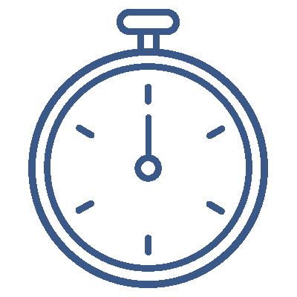
Instructor-Led Q&A
Questions
Do you have any experience with AI prototyping?
If yes, what tools have you used? How has your experience been?
If you don’t have any experience with AI prototyping, what potential do you see it having in your day-to-day work life?
Your Experience
With Prototyping
Q&A DISCUSSION
10 minutes
Feel free to post your answers in the chat or unmute and share!
To get you thinking, opening up and sharing your personal experience and knowledge with AI prototyping, discuss the following questions.
Notes:
Notes
💥Activity: Instructor-Led Q&A
💬Topic: AI Prototyping Experience
⏱️Time: 10 Minutes
To get you thinking, opening up and sharing your personal experience and knowledge with AI prototyping, discuss the questions on the slide.
Questions:
Do you have any experience with AI prototyping?
If yes, what tools have you used? How has your experience been?
If you don’t have any experience with AI prototyping, what potential do you see it having in your day-to-day work life?

Slide 8

AI Prototyping Tools
Organized by Skill & Purpose
Beginner / No-Code AI Prototyping | Design & Planning Tools | Hands-On Coding & AI Model Building | Cloud & AutoML Platforms | How to Choose for a Project
These tools help you build AI ideas without writing much code. Lovable: Ship AI-powered apps from text prompts. ChatGPT: Generate app logic and feature blueprints. Teachable Machine: Train vision and sound models instantly. Scratch + AI: Build interactive AI games and projects. MIT App Inventor: Create drag-and-drop AI mobile apps. | Great for wireframing and mapping AI concepts before building them. Figma: Design UI/UX for AI interfaces. Whimsical: Map logic flows and system architectures. Miro: Brainstorm and plan AI concept maps. | For deeper customization and real-world AI models. Python + Jupyter: Test experimental code and data models. TensorFlow: Experiment with large-scale machine learning. PyTorch: Build and refine custom neural networks. OpenCV: Develop vision systems for robotics. | Scale your AI prototypes and use powerful pre-built models. Google AutoML: Train high-end models without deep code. Azure AI Studio: Prototype within a cloud-native ecosystem. AWS SageMaker: Manage and scale complex AI workflows. | Idea → App (No Code): Lovable, ChatGPT Interactive Learning: Scratch, Teachable Machine Design First: Figma, Whimsical, Miro Deep AI / Custom Models: Python, TensorFlow, PyTorch Robotics + AI: Raspberry Pi, ROS, OpenCV Enterprise Scaling: Google AutoML, Azure AI Studio, AWS SageMaker

Slide 9



Final Project Explanation
Notes:
Notes
📌 Note for instructors: Please play this 3.5 minute video which explains in greater detail the requirements for students to complete their final project.

Slide 10
Deliverable
INCLUDE
Final Project
🎯 GOAL | Demonstrate your AI prototype, and explain its design and workflow via key artifacts. Then, share your group's key insights.
📝 DELIVERABLE | Google Slide Deck or PDF of deck
🕙 TIMING | [OPTIONAL] For those groups who wish to demo their prototype in Module 6, 7-10 minutes per group will be allotted. Note this is not mandatory for certification, but every group member must submit their deliverables deck/PDF.
1
AI Prototype Screenshots & Link
2
Prototyping Requirements One-Pager & Link
3
Insights on Debugging, Iterations & APIs
4
Insights from Build Process
5
Insights on Governance and Strategy
You can find the full brief here, which includes your deliverables template
Notes:
Notes
📌IMPORTANT: Note for instructor: After playing the video on the previous slide, spend a few minutes here in case students have any additional questions. You may want to recap on any of the following:
Walk Through the Requirements: Spend time opening the Final Project Brief and Deliverables Template on your screen. Meaningfully reviewing the scenario and the specific slides they will need to fill out is critical to reducing anxiety.
Establish Permanent Groups: Make it clear that the breakout groups assigned will be their permanent Project Teams for the duration of the course. They will return to these same groups in future modules to build their deliverables iteratively.
Confirm "No Homework" Policy: Emphasize that the project is designed to be completed entirely during designated in-class lab times. While students are welcome to meet outside of class to go the extra mile, it is not required for certification.
Set Expectations for Guidance: Inform students that you will map course content to their project deliverables as topics arise. However, they should take time at the end of class today to read the Brief and Template thoroughly to familiarize themselves with the end goal.
ℹ️ Final Project Details
Format: Students will demonstrate their AI prototype and explain its design and workflow with key artifacts. Then, they will share their group's key insights.
Deliverable: Students will complete the Final Project Deliverables Deck (via template). Each group member must submit a copy of their deck into the LMS to quality for certification. They can also submit the deck as a PDF.
Timing: [OPTIONAL] For those groups who want to demo during the final 30 minutes of Module 6, each group will have 10 minutes to present.

Slide 11
Agenda
01 Why AI Prototyping is the New PM Edge
02 Hands-On Lab: Build Your First Prototype with Lovable
03 The New Operating Model
04 Hands-On Lab: Add a Wishlist Feature To Your Prototype
Notes:
Agenda
Why AI Prototyping is the New PM Edge
Hands-On Lab: Build Your First Prototype with Lovable
The New Operating Model
Hands-On Lab: Add a Wishlist Feature To Your Prototype

Slide 12
Why AI Prototyping
is the New PM Edge
Notes:
01. Why AI Prototyping is the New PM Edge

Slide 13


From PRDs to Prompts
New Way: Acceleration
Product development can now move from concept to interactive prototype in minutes, enabling rapid validation and continuous refinement.
A well-structured single prompt creates a working app in minutes.
Stakeholders interact with real, live software.
Edge cases and iterations happen in real-time.
Product development required heavy documentation, sequential approvals, and long wait times between design, engineering, and feedback loops.
Detailed PRD, mocks, and MVPs took weeks.
Feedback often surfaced gaps late in the process.
The cycle of iteration felt long and disconnected.
📦 PRODUCT
📌 Key Takeaway: Prompts replace waiting with doing. They turn PM intent into functional prototypes that you can test, iterate, and scale.
Old Way: Approval
Notes:
Notes
With these new developments, how has AI prototyping changed the game in product management workflows? In a nutshell, when you can show a CFO or VP a working demo in days from weeks/months, you shift the conversation from ‘approval’ to ‘acceleration.
In the old way, creating a product involved long, sequential steps.
First, you’d write a detailed PRD, then move to design mocks, and finally, engineers would build an MVP.
This process could take weeks, and often, feedback wouldn’t come until much later in the cycle, by which point there were already gaps or issues to address.
It felt like a slow, disconnected process.
But now, with AI prototyping, we’re in a new era.
A single prompt can generate a fully functional app in minutes.
You no longer have to wait weeks to see a working version of your idea.
Instead, stakeholders can interact with real, live software from the start, which means they can provide feedback in real-time, uncovering issues or edge cases as they happen.
Key takeaway: AI won't replace PMs, but PMs who embrace AI-powered prototyping will have a distinct advantage. This skill elevates you from "manager" to "builder," enabling rapid validation and deployment of real AI-powered solutions..

Slide 14
The Barrier to Building Has Collapsed
You no longer need syntax to prove an idea; you just need logic. If you can write the spec, you can build the prototype.
SOFTWARE 1.0 Computer Code
SOFTWARE 2.0
Neural Networks
SOFTWARE 3.0 (NOW!) Language Prompts
Traditional Programming
Where you hand-wrote code line by line to define logic and behavior.
Machine Learning
Where you trained models on labeled data to recognize patterns and predictions.
Large Language Models
Where you describe to the model in natural language and it’s generated for you.
EXAMPLE
EXAMPLE
EXAMPLE
Write a Python function to classify reviews based on text keywords like “good” or “bad.”
Train an ML model on sentiment analysis using 10,000 positive and 10,000 negative labeled data sets
Prompt an LLM: “Classify this review as positive, negative, or neutral.”
Notes:
Notes
The world of software development has shifted, but the headline isn't just "AI is here." The headline is that the barrier to entry has collapsed. For the first time in history, the only requirement to build software is logic, not syntax.
Software 1.0: In Software 1.0, you were dependent on engineers. To classify reviews, someone had to manually write detailed code, line by line, to define every rule. If you couldn't write the syntax, you couldn't build the product.
Software 2.0: With Software 2.0, machine learning took over. Instead of coding rules, we trained models on massive datasets to recognize patterns. This was powerful, but it still required deep technical expertise to manage and label that data.
Software 3.0: Now, in Software 3.0, the interface is natural language. You don't need to know Python; you just need to describe your goal in plain English. To classify sentiment, you simply tell the model what you want, and it generates the code for you.
This means the technical wall is gone. You can now create real software flows without writing a single line of code. Your value has shifted from "writing specs for builders" to "being the builder" yourself. This is the essence of AI Prototyping—using this new power to validate your ideas with working software instantly, rather than waiting for permission.

Slide 15
The Era of Vibe Coding
👨‍💻 Vibe Coding
📐 AI Prototyping
PMs harness the power of vibe coding to execute the specific discipline of AI prototyping.
The Methodology: Embracing AI to translate plain language intent into code. It prioritizes rapid iteration and creativity "vibes" over micromanaged technical details or syntax.
The Application: Leveraging AI code generation to build functional prototypes instantly. Tools interpret prompts and designs to validate ideas without requiring coding expertise.
→
Notes:
Notes
You’ve likely seen these two buzzwords floating around LinkedIn: Vibe Coding and AI Prototyping. It’s important to understand that these aren't opposing forces; they are the "How" and the "What."
Vibe Coding:
Vibe Coding is the Methodology. This is the broader shift we are living in. It’s about embracing AI to translate your plain language intent into actual software code.
The term comes from the idea of "giving in to the vibes"—prioritizing creativity, speed, and intuition over micromanaging technical details or syntax. It’s the engine that makes all of this possible.
AI Prototyping:
AI Prototyping is the Application. This is how you, as a Product Manager, wield that power.
You leverage AI code generation to build functional prototypes instantly—interpreting your text prompts or sketches into working software.
Key Takeaway: You are using Vibe Coding tools (like Bolt or Lovable) to execute AI Prototyping workflows. This approach makes it accessible to visualize ideas and get them in front of users for feedback, all without needing deep technical expertise. It’s perfect for testing and validating ideas before you commit to full-scale development
.

Slide 16
PM Application
Vibe Coding & AI Prototyping
More on building prototypes with the FUDI Framework coming up in Module 2!
VIBE CODING
AI PROTOTYPING
Focus | Generating Code Using natural language to create software without worrying about syntax. | Validating Ideas Using that code to build interactive mockups that test specific hypotheses.
Output | Functional Software The AI writes the logic, backend, and frontend based on your conversational prompts. | Disposable Artifacts The goal isn't perfect production code; it's a "demo" build meant for user testing and handoff.
Iteration Style | "Vibing" Fast, intuition-based tweaking. You change the prompt until the app feels right. | Structured Learning You iterate using the FUDI Framework (Functionality, User flow, Design, Interaction) to ensure the prototype solves the user need.
Notes:
Notes
Let’s look at how these two approaches differ in practice. As a PM, you are shifting your operating model from the left column to the right.
Focus: In Vibe Coding, the goal is Generating Code. You are happy if the code compiles and runs. In AI Prototyping, the goal is Validating Ideas. You don't care if the code is elegant; you care if the feature solves the user problem.
Output: Vibe Coding produces functional software intended to be used. AI Prototyping produces disposable artifacts or demos.. This is a critical mindset shift: you must be comfortable building something that is meant to be thrown away or handed off to engineering as a reference, not a final product.
Iteration Style: Vibe Coding relies on intuition—tweaking the prompt until it "feels" right. AI Prototyping relies on Structure. In Module 2 we will introduce a key framework here called FUDI: Functionality, User flow, Design, and Interaction. You don't just "vibe" with the bot; you iterate and build your prompts systematically against these four pillars to ensure the prototype meets business requirements, not just aesthetic ones.
Let’s connect this with a real-world analogy: Imagine you are a PM at Slack, and you have an idea for an "AI Summary for Huddles."
If you were Vibe Coding: You’d prompt the AI to "write a Python script that listens to audio and outputs text." You’re focused on the technical challenge: "Can I make this code work on my laptop?
If you are AI Prototyping: You’d prompt the AI to "build a UI where a user clicks 'Summarize' inside the Huddle window and sees a bulleted list." You are focused on the user value: "Will people actually click this button?"

Slide 17
AI Prototyping By Industry/Domain
Real-World Examples
Enterprise / SaaS
Salesforce: Prototype AI-powered sales pipeline recommendations → see edge cases, scoring logic, and UX before engineering
ServiceNow: AI generates IT workflow suggestions → validate logic and escalation paths rapidly
Healthcare / Safety
AI Fitness & Wellness Apps: Generate safety-first plans (exercise/diet) → validate constraints without risk
Hospital Workflow Tools: AI simulates multi-step patient intake and triage workflow → test errors, bottlenecks, and clarity
EdTech / Robotics
Duolingo / Khan Academy: AI generates step-by-step lesson plans or problem sets for learners → validates pedagogy and engagement

Slide 18
AI Prototyping By Industry/Domain
Real-World Examples
Tech / Software
Google: Prototype multi-step admin dashboards & user flows internally with AI prompts → validate workflow logic before engineering.
Microsoft (Copilot, Teams AI): AI generates meeting summaries, task prioritization, and workflow automation prototypes → eliminate manual coding for initial logic tests.
Meta: AI prototype for content moderation workflow → test edge cases safely before building full system.
Consumer/Fitness
Peloton / Fitness Apps: Generate personalized workout plans and schedules in AI prototype → validate UX and personalization logic before building.
Weight-Loss Apps (Noom, MyFitnessPal): Rapidly test AI-driven daily meal plans, habit tracking, and push notifications → refine engagement hooks prior to development.

Slide 19





AI Prototyping Key Benefits
Technical Autonomy
Instant Validation Loops
Functional “Living” Specs
Compressed Product Lifecycle
Stop trading documents. You can build functioning products using natural language, removing the "Engineering bottleneck" for early-stage validation.
Move from "design critique" to "user behavior." Test and refine concepts in real-time with live software, not static mocks.
Replace static requirements with interactive prototypes. You show engineering exactly how the logic works, drastically reducing ambiguity and rework.
Shrink the idea-to-validation cycle from weeks to hours. You can fail faster and cheaper before committing expensive production code.
Notes:
Notes
Why does this shift matter? It’s not just about "building cool stuff." It’s about four strategic advantages you gain as a PM.
Technical Autonomy You stop being a "Requestor." You don't have to beg for engineering resources just to test an idea. You build it yourself using natural language.
Instant Validation Loops Static mocks lie. People say they "like" a drawing, but they might not use the product. With a live prototype, you get instant truth about user behavior.
Functional “Living” Specs This is huge for your relationship with engineering. Instead of writing a confusing document, you hand them a working app. It removes the ambiguity of "I thought you meant X".
Compressed Product Lifecycle You are shrinking the Product Development Life Cycle. You are finding the failure points in the afternoon, not three weeks into the sprint. That saves money and saves face.

Slide 20
AI Prototyping in the Product Life Cycle
STAGE
TRADITIONAL PM ROLE
AI PROTOTYPING EDGE
→
Brainstorming: Generating abstract ideas on sticky notes or whiteboards for future consideration.
Visualization: Generating low-fidelity visuals instantly to test concept viability before committing
💭 Ideation
→
Spec Writing: Creating static PRDs that describe requirements textually.
Living Specs: Prompting the AI to demonstrate flow and logic rather than just describing it.
✏️ Definition
→
Waiting: Relying on UX to create initial mockups for validation.
Building: Creating high-fidelity prototypes to validate user value before pixel-perfect polishing.
✍ Design
→
Hand-off: Passing static documents to engineering and clarifying tickets during the build.
Reference Implementation: Handing off a working codebase (GitHub) that proves the logic.
🛠️ Development
→
QA Review: Checking if the coded features match the written PRD requirements.
Behavioral Validation: Comparing the final build against the interactive prototype to ensure fidelity.
🧪 Testing
→
Release Management: Coordinating rollout schedules and managing marketing support for the launch.
Rapid Iteration: Using AI to analyze live feedback and prompt immediate hotfixes or changes.
🚀 Launch
Notes:
Notes
AI Prototyping accelerates the entire lifecycle, but its highest leverage is in Definition, Design, & Development. This is where you replace static documents with interactive proof.
How this changes the PDLC as a whole: Traditionally, the PDLC is a game of "telephone"—you pass documents from Definition to Design to Development, and meaning gets lost at every step. AI Prototyping changes the fundamental currency of this lifecycle. You stop passing static documents downstream and start passing validated behaviors. By introducing working software in Stage 2 instead of Stage 4, you eliminate the "translation errors" that cause expensive rework later.
In a nutshell: The "New Edge" for PMs isn't just about moving faster; it's about moving validation upstream. Traditionally, you don't know if a product works until Stage 4 or 5. With AI Prototyping, you know in Stage 2.
This course empowers you to take ownership of the messy middle—Definition, Design, and Development handoff.
In Module 3: You’ll stop writing static specs and start building "Living Specs." You’ll use a Simplified PRD to drive the AI.
In Module 4 & 5: You’ll stop waiting for permission. You become a Builder, creating high-fidelity prototypes to test with users immediately.
In Module 6: You’ll stop handing off PDFs. You Outsource the initial architecture to GitHub. You hand off a working codebase that answers the engineers' questions for them.
Now, a critical clarification: Does this mean you are replacing the Product Designer or the Engineer? No.
You build the prototype to prove the Value (Is this the right thing to build?).
You hand it to Design to perfect the Usability (Is this the right way to build it?).
You hand it to Engineering to build the Scalability (Will this work for 1M users?).
You aren't doing their jobs. You are giving them a validated, de-risked starting point so they don't waste their time building things users don't want.

Slide 21

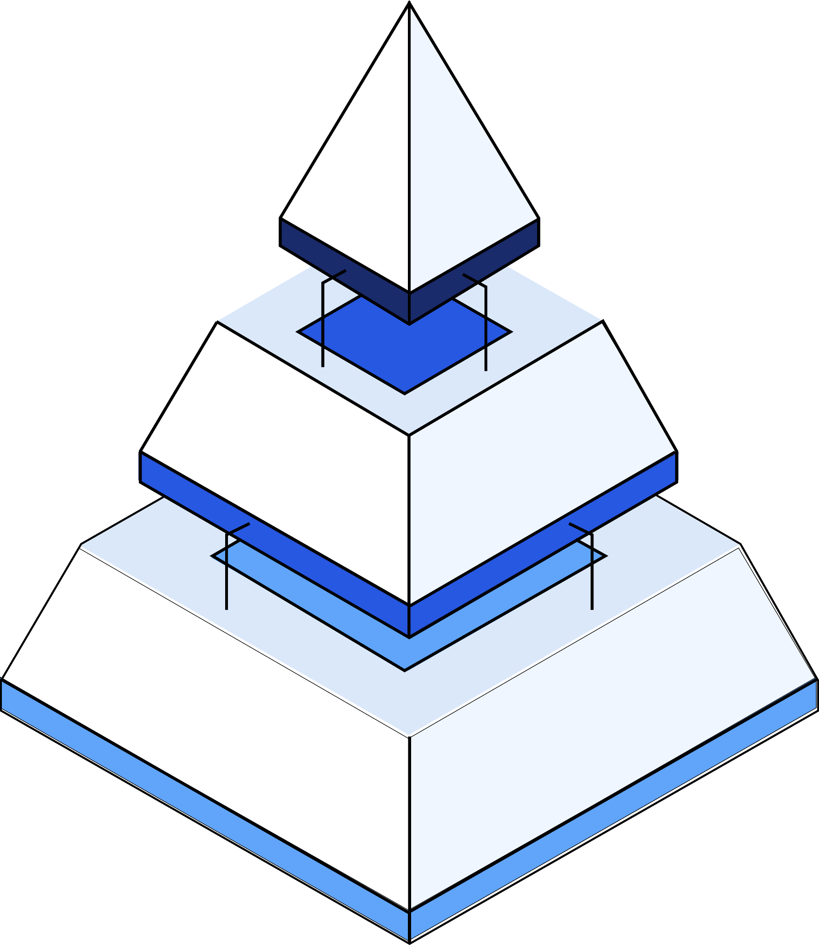


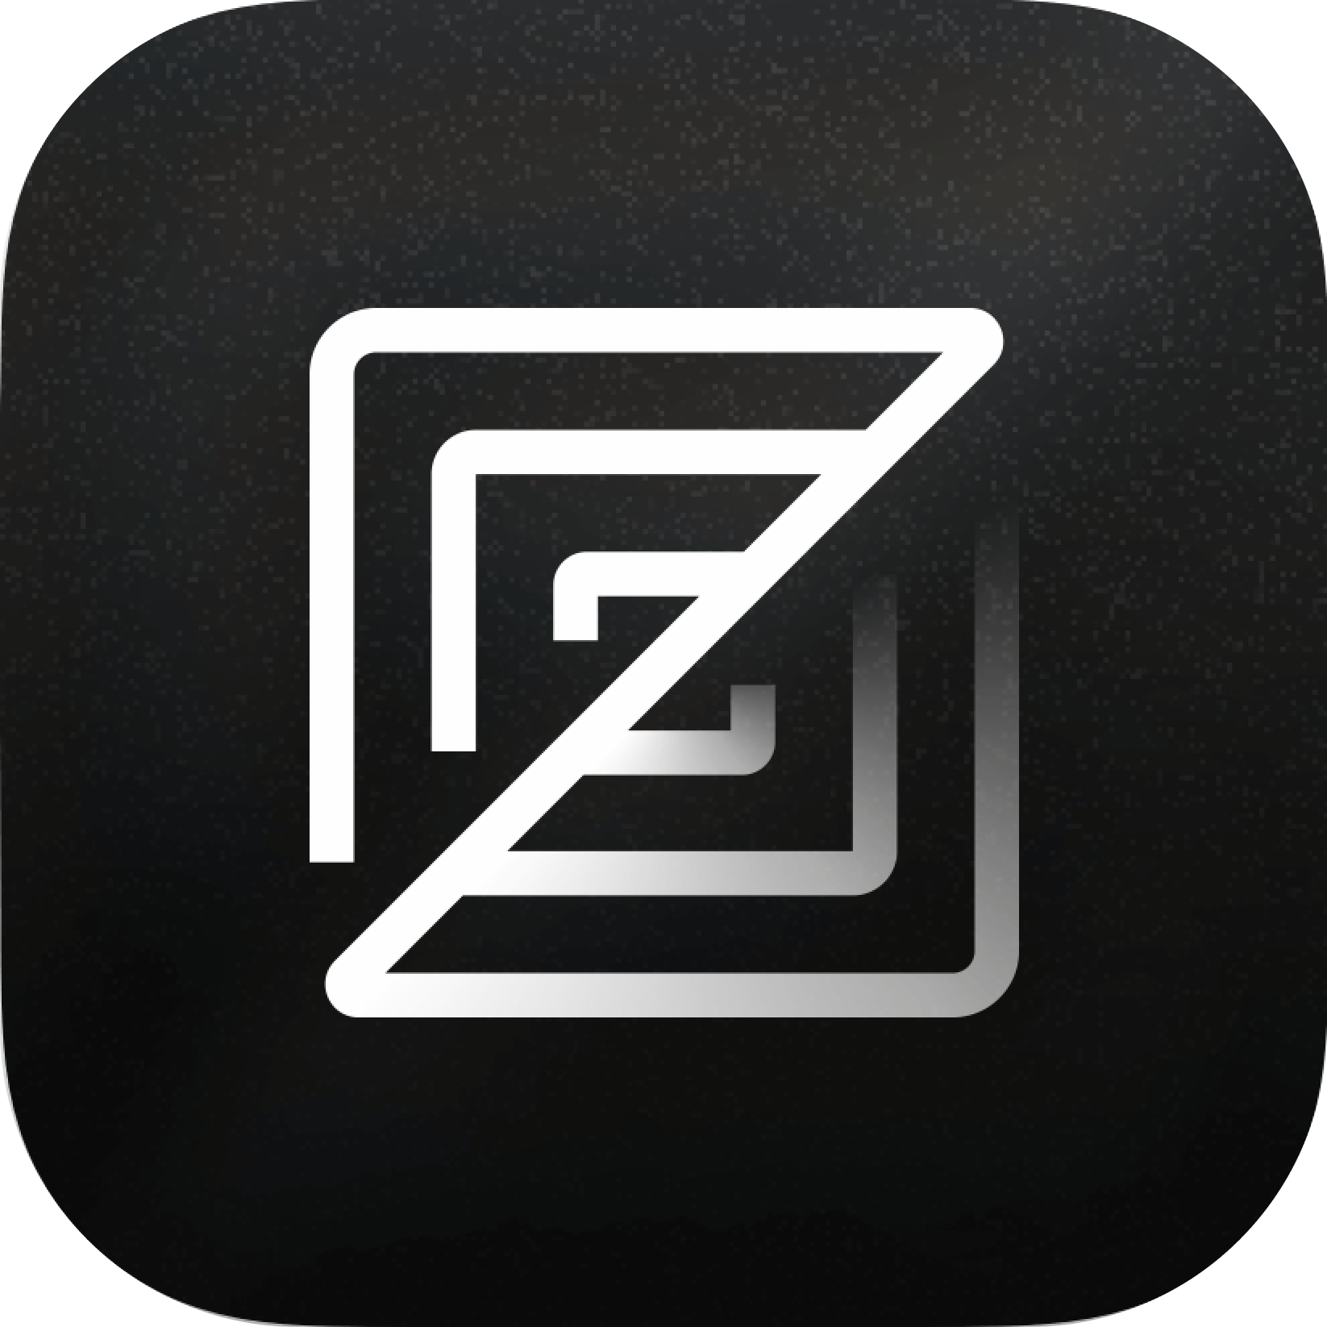





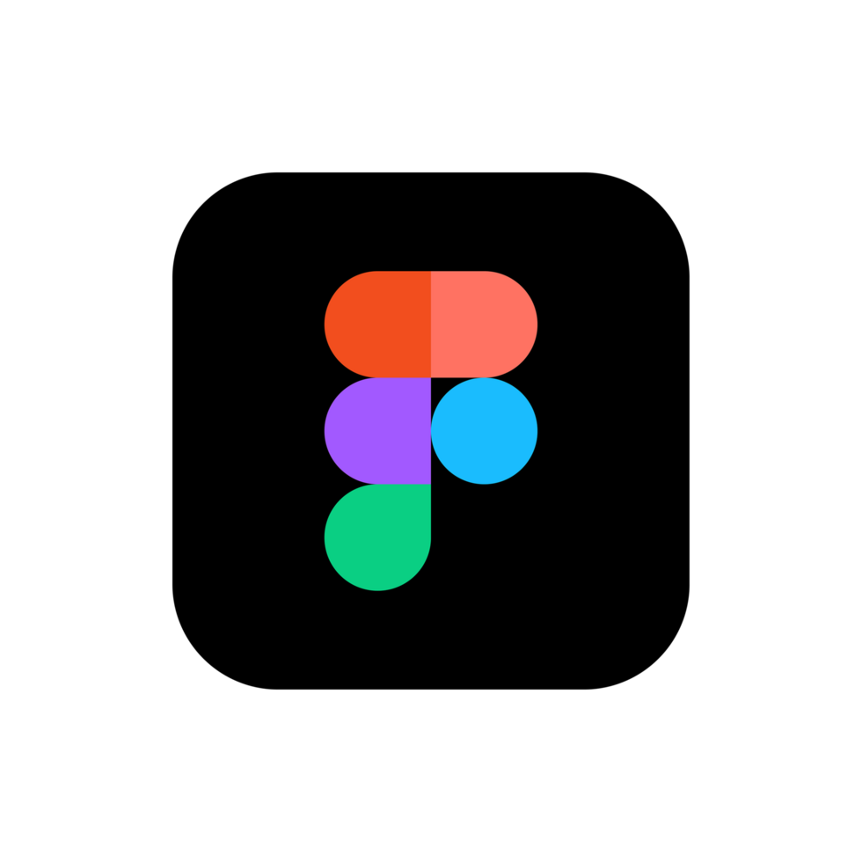




AI Prototyping
Tool Stack
KEEP IN MIND AI is a rapidly evolving space that changes quickly! Look out for new, emerging players.
PRODUCTION ENGINEERING (Local IDEs)
Use these for deep engineering work to scale the codebase and integrate directly into production environments .
Examples: GitHub Copilot, Cursor, Zed, Windsurf
COURSE FOCUS
FULL-STACK PROTOTYPING (Cloud IDEs)
Use these to build and deploy functional, interactive web app prototypes instantly without any local setup.
Examples: Lovable, Bolt, Replit, v0, Figma
PROTOTYPE ARCHITECTURE (Chatbots)
Use these to architect the prototype, generate a Simplified PRD and structure prompts that drive the build.
Examples: ChatGPT, Claude, Gemini.
Notes:
Notes
Not all AI tools are builders. To choose the right instrument, you must distinguish between tools that generate text and tools that deploy software. Your goal is to start at Tier 1 to plan, move to Tier 2 to build, and hand off to Tier 3 to scale.
Tier 1 - Architecture: This is the foundation of your prototype. You don't skip this. You use tools like ChatGPT or Claude to write your Simplified PRD and generate the complex prompts. You define the logic here so you don't have to think of it while you're building.
Tier 2 - Prototyping: This is our focus. You take the prompts you wrote in Tier 1 and feed them into tools like Lovable or Bolt. These tools give your logic a body—deploying actual web apps instantly. This is the sweet spot for PMs because it removes the technical barrier.
Tier 3 - Production Hand-Off: Tools like Cursor live on an engineer's laptop. They are for production scaling. Unless you are a former engineer, you will likely hand off your Tier 2 prototype to a developer using Tier 3 tools to take it to the enterprise/production level.
Keep in mind: The AI landscape is rapidly evolving day-by-day. To be a great AI PM, you need to keep tabs on current tools and functionalities to stay on top and relevant.

Slide 22
Clone Your LinkedIn Feed With Lovable
Hands-On Lab
Notes:
Hands-On Lab: Clone Your LinkedIn Feed With Lovable

Slide 23
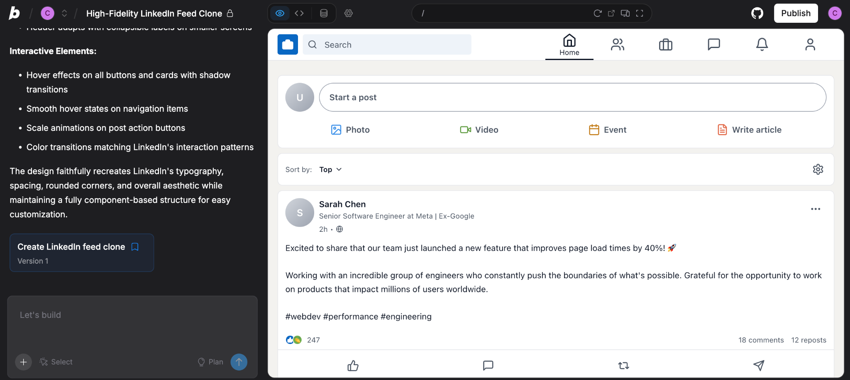
Instructor-Led Exercise
LAB EXERCISE OUTCOME
Clone Your LinkedIn Feed
With Lovable
Notes:
Notes 📌 Note for Instructors: Briefly give a sneak peak of what students will be building, highlighting that this will be the final outcome of the exercise, and together with students you will walk through the steps together.

Slide 24

Instructor-Led Exercise
Steps to follow:
💡IMPORTANT: Make sure you have signed up for a Pro Lovable Account
Open 🔗 Lovable
Use the prompts in the walkthrough guide, linked below, and follow along with instructor, step-by-step.
Use a screenshot of your LinkedIn feed, or the page URL to clone the feed and have Lovable create a replica.
💡If you prefer a screenshot tool to capture your LinkedIn feed, try Go To Full Page for Chrome, Awesome Screenshot, or Nimbus Screenshot
Clone Your LinkedIn Feed with Lovable
LAB EXERCISE
15 minutes
In this hands-on lab, you’ll use Lovable to create a replica of LinkedIn in minutes.
Your goal is to prompt Lovable to clone the LinkedIn Feed page.
Keep in mind: This lab uses a screenshot as just one example of an entry point for quick mockups. AI prototyping tools can often start from various entry points, including text prompts, Figma designs, or even hand-drawn wireframes, depending on what assets you have!
✍️ Follow along with our walkthrough here
Notes:
Notes
💥Activity: Instructor-Led Exercise
✏️Task: Clone Your LinkedIn Feed with Lovable
⏱️Time: 15 Minutes
📌 Note for Instructors: It is important that you run through this exercise and demo it before hand to practice. During the lab, you should ask one student to be your volunteer and share their screen. They will listen to YOUR instructions as you walk them through the steps while all other students following along on their own computers. If students get stuck, let them know they have the instructions and prompts in the walkthrough guide linked on the slide. Make sure you share the link to the guide with students.
Scenario: In this hands-on lab, you’ll use cloud-based tool Lovable to clone the LinkedIn Feed in minutes! The goal is to experience firsthand how AI prototyping tools can 10x your speed, allowing you to move from idea to interactive build in minutes.
Instructions:
👉 Make sure students are following along with the detailed walkthrough guide and share your screen to walk through the steps together!
Open Lovable.dev
Choose the method to prompt Lovable to replicate LinkedIn’s homepage: A) With a screenshot and the prompt provided or B) With only the prompt provided.
Once students finish ask them to share their thoughts on the process of using Lovable and the tool’s functionality with the following questions:
What was the most surprising or impactful aspect of using the AI prototyping tool?
Did you run into any friction points? If so, where?
What would you have liked to learn more about?

Slide 25
Instructor-Led Q&A
Discuss the following questions
Why would a PM choose to "clone" an existing pattern (like a feed or a dashboard) rather than building from a blank page? How does this change your speed-to-validation?
We used a screenshot to start this build. If you didn't have a screenshot, what other assets (sketches, files, docs) do you have on your desk right now that you wish you could just "upload" to start a build?
Q&A DISCUSSION
5 minutes
LinkedIn Clone Debrief
Feel free to post your answers in the chat or unmute and share!
You just cloned a major social network in less than 15 minutes. Let's reflect on the strategic value of this workflow.
Notes:
Notes
💥Activity: Instructor-Led Q&A
💬Topic: Multi-Agent Workflow Debrief
⏱️Time: 5 Minutes
📌 Note for Instructors: Frame the exercise as “Why did we just do this?”
It wasn't to steal LinkedIn's IP. It was to cure "Blank Page Syndrome."
As a PM, you rarely need to invent a UI from scratch. Users like familiar patterns. Cloning a standard "Feed" or "Dashboard" gives you a high-fidelity baseline in seconds, so you can spend your time innovating on what’s next, not the layout.
Instructions: To reflect upon what you’ve learned today, discuss the following questions with students and get their insights.
Questions:
Why would a PM choose to "clone" an existing pattern (like a feed or a dashboard) rather than building from a blank page? How does this change your speed-to-validation?
We used a screenshot to start this build. If you didn't have a screenshot, what other assets (sketches, files, docs) do you have on your desk right now that you wish you could just "upload" to start a build?

Slide 26
Estimated time: 5 minutes
Notes:
Notes
Time for a 5-minute break—you’ve earned it! ☕

Slide 27





Reminder! 🚨
It's always better to see your smiling face! Be present and visible to stay engaged and keep interactions valuable.
Cameras On

Slide 28
The New Operating Model
Notes:
03. The New Operating Model

Slide 29
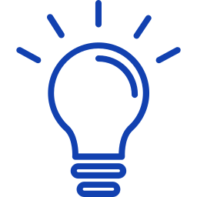


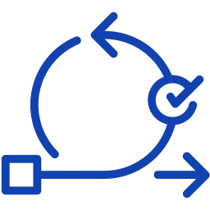
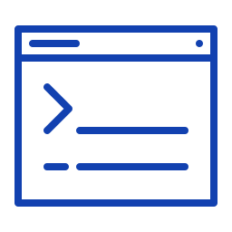

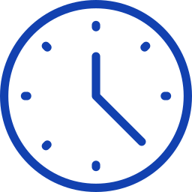



PM Independence is ROI
The New Operating Model
Old Way: Dependency Loop
New Way: Builder Loop
PRODUCT DEVELOPMENT
LOOP
AI PROTOTYPING LOOP
Idea
Idea
Wait for Update
Write Spec
Prompt
the Prototype
Iterate
Feedback
Wait for Eng / Design
Hand Off Validated Spec
Test Live App
Review Mock
AI prototyping doesn’t replace design or engineering—it removes the waiting that used to block learning.
Notes:
Notes
So, why does this distinction matter? Because it fundamentally changes your operating model as a PM.
The Old Way was the "Dependency Loop." You had an idea. You wrote a spec. Then you waited. You waited for a designer to mock it up. You waited for an engineer to build the MVP. You were a "Requestor," always dependent on someone else's time to see your idea come to life.
The New Way is the "Builder Loop." With AI Prototyping, you remove the wait time. You have an idea, you prompt the prototype, and you have a working, testable app in minutes. You validate the value before you ask for budget.
The ROI is Independence. You stop trading static documents that no one reads, and you start trading live links that people can use. You can now validate an idea in an afternoon that used to take a month.

Slide 30
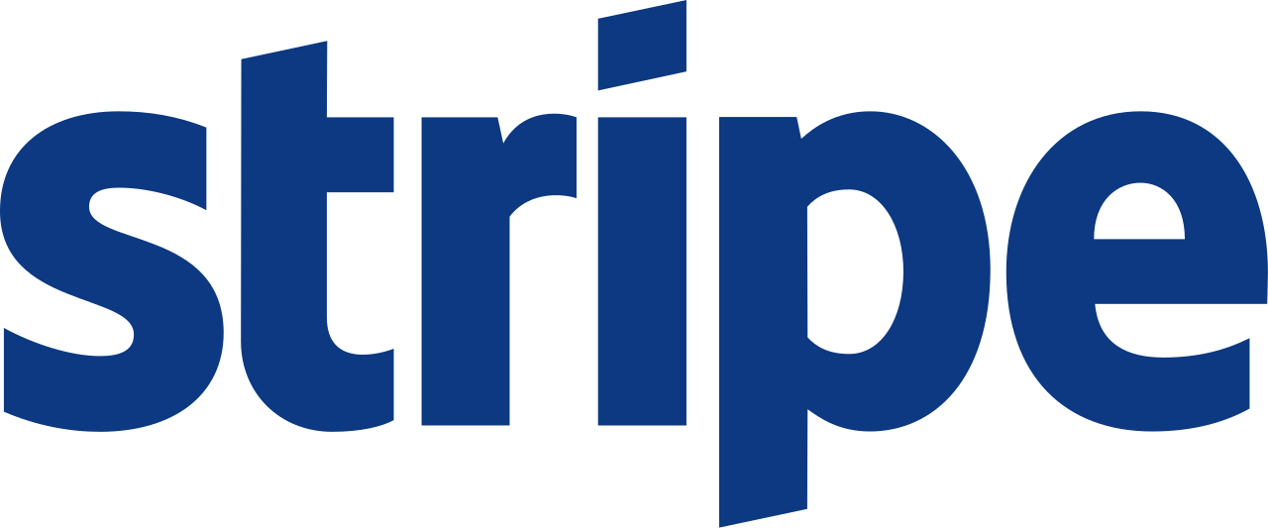

Where AI Prototyping Changed PM Leverage
PMs Simulate:
Developer onboarding flows
Error handling scenarios
API documentation clarity
True Value Add
Docs + UX validated before code
Engineers build APIs that match mental models
Lower integration friction for developers
PMs Simulate:
Guest/host messaging flows
Trust & safety explanations
Support resolution paths
True Value Add
Faster iteration on emotional UX
Reduced policy confusion
Better host/guest trust signals

Slide 31

Where AI Prototyping Changed PM Leverage
PMs Simulate:
Search result layouts
Policy enforcement flows
Ads ranking explanations
True Value Add
Validated workflows instead of abstract PRDs
Weak ideas killed before design investment
Faster alignment across Search, Ads, trust & safety
(Copilot, Office, Teams)
PMs Simulate:
Simulate user prompts Stress-test Copilot responses Prototype multi-step workflows (email → calendar → tasks)
True Value Add
Reduced UX rework
Fewer “this isn’t what I meant” cycles
Copilot shipped with higher confidence in real usage patterns

Slide 32

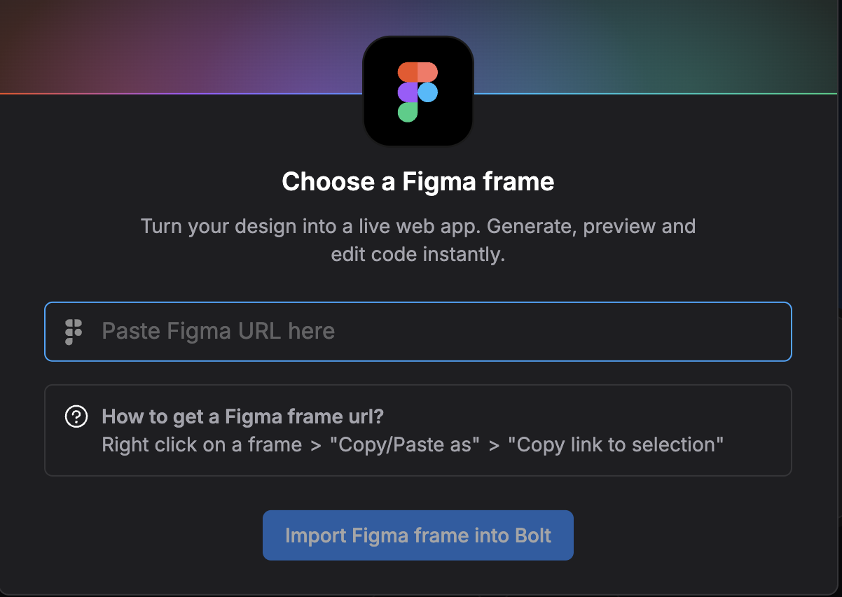
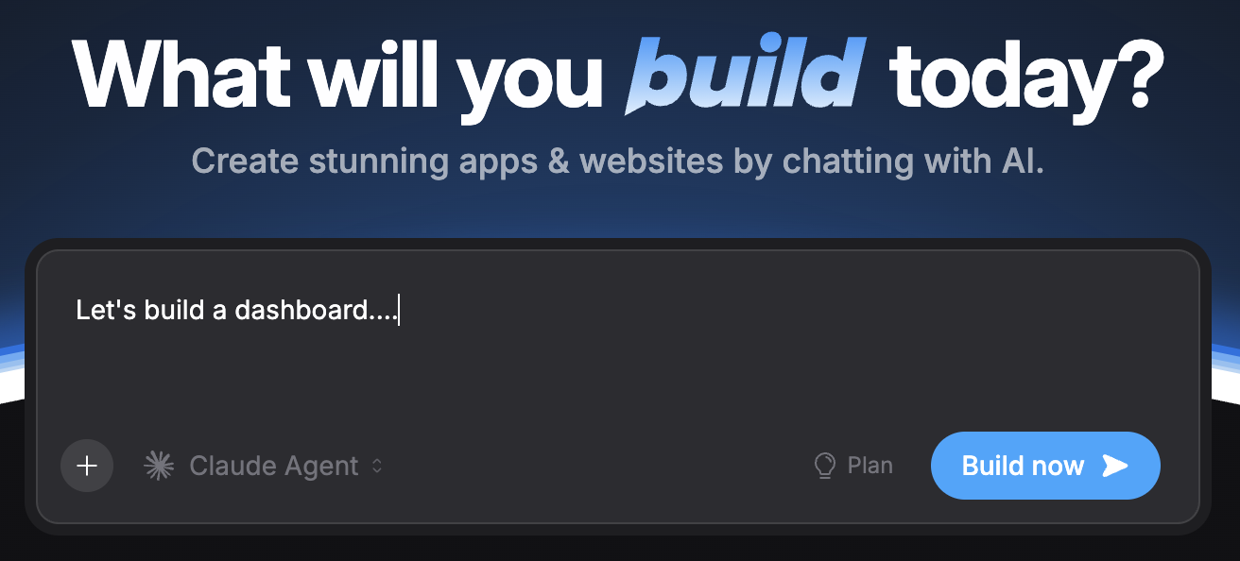
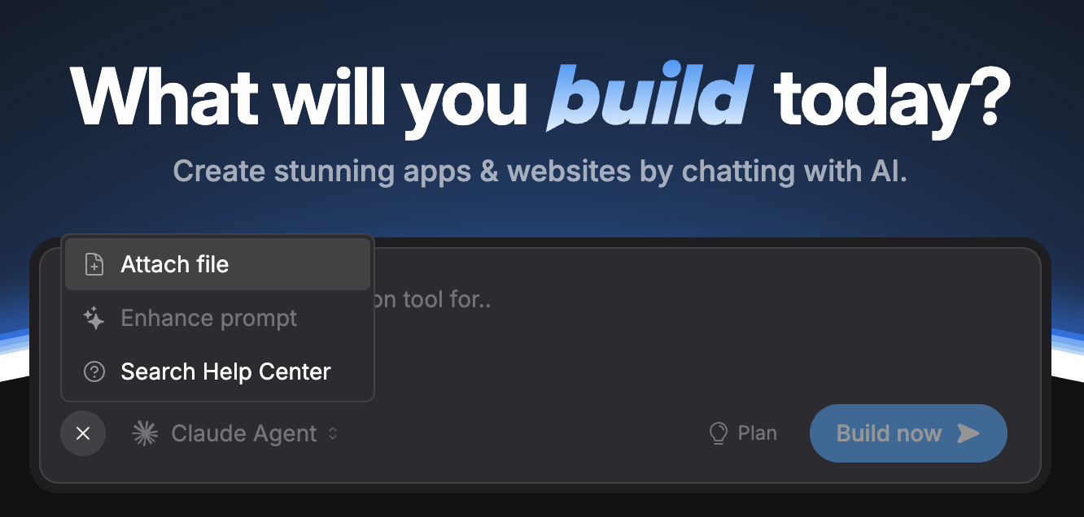
Bridging Design and Build
Multimodal AI prototyping bridges design and build by making UX, logic, and interaction evolve together—before code ship.
Here are the three most common entry points to bridge the gap between design requirements and your prototype.
1
Text-To-App
2
Screenshot-to-App
3
Design-to-Code
Natural language prompts.
Best For: New concepts, rough ideas, or solving a problem where no design exists yet.
Uploading a screenshot.
Best For: Cloning existing patterns or digitizing a whiteboard sketch.
Figma imports or design system docs. Best For: Transforming existing high-fidelity visuals into functional code without manual re-creation.
Notes:
Notes
One of the biggest misconceptions is that AI Prototyping means "starting from scratch" or "going rogue" with the design. The reality is that these tools are Multimodal. They don't just read text; they read pixels and code. This gives you three entry points:
Text-to-App: This is your "Zero to One" tool. It’s great for speed when you have a blank canvas.
The Value for PMs: It cures "Blank Page Syndrome." You don't need a wireframe; you just need a problem statement. You can say, "Build a dashboard for tracking churn," and get a visual starting point in seconds. It’s perfect for rapid ideation when you are still figuring out what to build.
Screenshot-to-App: This is your "Pattern Matching" tool. It’s what we did in the LinkedIn lab. You upload a screenshot of an existing app or a photo of a whiteboard sketch.
The Value for PMs: It bridges the gap between "Analog" and "Digital." If you sketched a great flow on a whiteboard during a meeting, you don't need to redraw it in Figma. You just snap a picture, upload it, and the AI turns your rough drawing into clean code. It preserves your layout intent perfectly.
Design-to-Code (Figma): This is the "Translation" tool. This is the game-changer for teams with existing assets. You can often import your existing Figma designs or paste your brand guidelines directly into the tool.
The Value for PMs: It solves the "Consistency" problem. Usually, prototypes look like toys because they use generic fonts and colors. By importing your Figma assets, your prototype looks "on-brand" from minute one. This removes the "it looks ugly" objection from stakeholders and lets them focus on the functionality.
This means you aren't ignoring your company's Design System; you are ingesting it. You can build a prototype that follows your brand's strict font, color, and spacing rules automatically. This bridges the gap between "rough idea" and "official product" instantl

Slide 33
Add a Wishlist Feature To Your LinkedIn Clone
Hands-On Lab
Notes:
Hands-On Lab: Add a Wishlist Feature To Your LinkedIn Clone

Slide 34
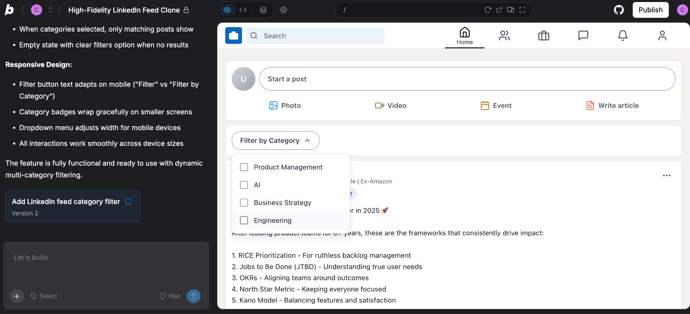
Instructor-Led Exercise
LAB EXERCISE OUTCOME
Add a Wishlist Feature To Your LinkedIn Clone
Notes:
Notes 📌 Note for Instructors: Briefly give a sneak peak of what students will be building, highlighting that this will be the final outcome of the exercise, and together with students you will walk through the steps together.

Slide 35
Instructor-Led Exercise
Steps to follow:
Return to your prototype in 🔗 Lovable
Use the prompts in the walkthrough guide, linked below, and follow along step-by-step.
Paste the prompt into Lovable and watch your new feature come to life!
💡Our Suggestion: We all use LinkedIn, but the feed is noisy.You can't easily see posts about specific topics. Build a "Topic Filter" bar that instantly sorts the feed. Or, feel free to prompt for another feature you would love to see!
Add a Wishlist Feature To Your Prototype
LAB EXERCISE
15 minutes
In this hands-on lab, you’ll return to your prototype to visualize a "Wishlist Feature"—something you wish the product had but doesn't exist yet.
Your goal is to prompt the tool to build a net-new feature that solves a real user pain point.
Keep in mind, this is an LLM so everyone’s output might look a little different, and that’s ok!
✍️ Follow along with our walkthrough here
Notes:
Notes
💥Activity: Instructor-Led Exercise
✏️Task: Add a Wishlist Feature To Your Prototype
⏱️Time: 15 Minutes
📌 Note for Instructors: As students have hopefully gained some confidence using Lovable, instruct them to each try on their own using the walkthrough (share your screen, open the guide, and walk through each step), asking them to complete it in real-time, pausing when needed and troubleshooting those that get stuck.
Suggest that if students have another idea, something they would love to see LinkedIn have, but know it doesn’t yet exist, they can try that prompt instead. Use the filter option only if they are short on ideas!
Scenario: In this hands-on lab, you’ll return to Lovable and take your prototype to the next level by prompting the tool to add a homepage filtering feature for posts.
Instructions:
👉 Make sure students are following along with the detailed walkthrough guide. - Note this is only for the Filter Feature, so if students choose something else, the guide won’t give them the prompt.
Return to the LinkedIn prototype from the previous lab in Lovable
If students closed the tab, they can find it by clicking on the profile button in the button left corner and choosing their LinkedIn project from the dropdown list
Using the prompt provided in the walkthrough, paste it into the chat in order to generate a new filtering feature.

Slide 36
Instructor-Led Q&A
Discuss the following question
How does this exercise change how you'd approach getting stakeholder buy-in for an iteration on your current product?
What is one feature you've been hesitant to explore for your own product that you now feel you could prototype and test using this method?
Q&A DISCUSSION
5 minutes
LinkedIn Wishlist Feature Prototype Debrief
Feel free to post your answers in the chat or unmute and share!
To reflect upon what you’ve learned today, discuss the following questions
Notes:
Notes
💥Activity: Instructor-Led Q&A
💬Topic: Multi-Agent Workflow Debrief
⏱️Time: 5 Minutes
Instructions: To reflect upon what you’ve learned today, discuss the following questions with students and get their insights.
This lab just lowered the 'cost' of testing a new feature on a complex, existing UI to almost zero.
Questions:
How does this exercise change how you'd approach getting stakeholder buy-in for an iteration on your current product?
What is one feature you've been hesitant to explore for your own product that you now feel you could prototype and test using this method?

Slide 37

Prototyping for Alignment and Velocity
Strategic Alignment
Validation Velocity
Goal: De-Risk the Solution Align diverse stakeholders around a complex vision before a single Jira ticket is written.
The prototype acts as a living spec.
You hand off the live link to demonstrate the exact logic and flow instead of writing a PRD.
If there is ambiguity, you fix it in the prototype, preventing expensive rework later.
Goal: De-Risk the Problem Prove that users actually want this feature before you commit to code and resources.
Your prototype acts as a test subject.
You ship the live link to get behavioral data around clicks and usage.
If the data is poor, you iterate, pivot, or delete it instantly.
IMPACT
IMPACT
Zero Expensive Rework: You prevent the "misinterpretation loop" where Engineering spends weeks building the wrong thing.
Zero Wasted Runway: You avoid the fatal mistake of hiring a team to build a product that no one wants.
Notes:
Notes
📌Note for instructors: This is an excellent spot for you to share your own personal experience with prototyping. Students love to hear how you have done things with past products, so please feel free to talk about your knowledge and experience.
A common question you might have is: "How do I actually use this at my job?" The answer isn't about where you work; it's about what you are trying to de-risk right now: the Solution or the Problem.
Strategic Alignment (De-Risking the Solution) Use this mode when you have a complex vision and diverse stakeholders (like Design, Legal, and Engineering) who all speak different languages.
The Workflow: You stop writing static PRDs that get misinterpreted. You use the prototype as a "Living Spec."
The Win: Instead of arguing over a document, you hand off a live link. You show Engineering exactly how the logic works and show Legal exactly what the user sees. This kills the "misinterpretation loop" instantly, ensuring zero expensive rework.
Validation Velocity (De-Risking the Problem) Use this mode when you are hunting for value and don't know if users even want the feature yet.
The Workflow: You don't wait for resources. You treat the prototype as a "Test Subject." You ship the live link to users immediately to get behavioral data (clicks and usage).
The Win: If the data is poor, you pivot or delete it instantly. You find out the idea isn't viable before you commit code or resources, ensuring zero wasted runway

Slide 38
The AI Prototyping Principles
Build With Intent
Ship Imperfections
Bridge the Gap
Embrace Disposability
🏗️
📦
🤝
♻️
Stop requesting; start translating. Use your build as a "Reference Implementation" to show Eng exactly how the logic functions, eliminating ambiguity and expensive rework.
Value the insight, not the asset. Treat the prototype as a disposable learning vehicle; once validated, discard the code so Engineering can build the scalable version
Move from "exploring" to "executing." Use a Simplified PRD to anchor every prompt in a specific user problem, ensuring you generate a solution, not just a feature.
Prioritize signal over polish. Deploy a "Rough V1" prototype in a user's hands to generate actionable data; a perfect prototype on your laptop generates nothing.
More details on the Simplified PRD coming up in Module 3.
Notes:
Notes
Finally, let's close with the four operating principles that define this new way of working. We know why we're doing it, but how do you actually work this way on a Tuesday morning? You need to break four traditional PM habits.
Technical Autonomy (Build With Intent): It is easy to get lost in the "magic" of the tool. The pro move is to anchor yourself. Use your Simplified PRD as the source of truth. If the prompt doesn't solve a problem defined in the PRD, don't write it. This ensures you are building value, not just noise .
More on what to include in your simplified PRD in Module 3.
Instant Validation (Ship Imperfection): We are trained to polish. You need to unlearn that. In this model, "perfect" means "too late." Your goal is Signal. If you wait until the UI is pretty, you've wasted days. Ship the rough version. If users click the ugly button, you have a business case. If they don't, no amount of polish would have saved it .
Functional Alignment (Bridge The Gap): This is your superpower with Engineering. Stop writing 20-page docs that get misinterpreted. Hand them a "Reference Implementation." When you show them exactly how the data loads or how the interaction feels, you cut weeks of "clarification meetings" out of the schedule .
Strategic Focus (Embrace Disposability): This is the hardest shift. You built it, so you want to keep it. Don't. The prototype is disposable. Its only job was to prove the idea. Once validated, let it go. The asset isn't the code you wrote; the asset is the confidence you gained to build the real thing .

Slide 39




The Zero-to-One Velocity Shift
The Old PM
The AI Prototyping PM
You didn't just learn a tool today. You just gave yourself a 10x promotion by collapsing a 2-week sprint into an afternoon.
❗
Input: 40 Hours (PRDs, meetings, reviews)
Input: 2 Hours (prompting and iterating)
Output: 1 Static Document (maybe read by 3 people)
Output: 1 Interactive Build (with real code that actually runs)
Leverage Ratio: 1:1
Leverage Ratio: 10:1
Notes:
Notes
📌 Note for instructor: Use this slide as a way to not only share today’s accomplishments but get students excited about what’s to come!
As we wrap up today, let’s look at the math of your new operating model. This isn't just about speed; it's about velocity and leverage.
In your day job, how long does it usually take to go from "I have an idea" to "I am holding a working app"? Two weeks? A month? You write docs, you wait for design, you wait for engineering. Look at what you did today. You walked in here with nothing. In 15 minutes, you cloned a major social network. You didn't write code. You didn't ask a developer. You just built it.
You have collapsed a 2-week sprint into 15 minutes. That isn't just "faster, that is independence. You are leaving this room as a Builder.
Coming up in Module 2, we stop cloning other people's apps and start building yours. We’re going to take this raw speed and apply it to Advanced Prompting so you can build anything you can imagine.

Slide 40
Key Takeaways
Accelerate the Idea-to-Validation Cycle
Product Managers don’t need to code, they need AI fluency and product thinking. Using AI as a prototyping partner is becoming a core skill for modern PMs, replacing traditional coding in early product work.
AI prototyping enables Product Managers to validate ideas at the speed of conversation. This unlocks faster feedback, sharper insights, and earlier alignment without waiting on design or dev cycles.
PMs can navigate AI tools using a maturity ladder: Chatbots → Builders → Local Dev Assistants. Each step increases control, complexity, and collaboration, aligning tools with product stage and skill level.
AI prototyping helps Product Managers validate ideas with clarity and structure. This builds credibility with stakeholders and enables cleaner handoffs for engineering execution.
Notes:
Notes
At the end of each module, recap key concepts and content covered in today’s lesson.

Slide 41
Write Advanced Prompts for High-Fidelity Prototypes
Extra Practice
Optional: Dig deeper into your hands-on lab experiences and try these exercises on your own.
1. Build a Prototype From an Existing Figma Design
//PROMPT
Prototype to match this design. Match it exactly. Use Tailwind Css.Match styles, fonts, spacing, and colors.
[Include a single screenshot from Figma].
2. Convert a Hand-Drawn Mockup to a Prototype
//PROMPT
Convert the hand-drawn sketch to a functional prototype. Focus on frontend. Functionality. Make it in the style of [product you like].
⏩ Next Session
Overview
Apply core, strategic, and cutting-edge prompting techniques to accelerate prototyping.
Use the FUDI framework to structure prompts that reduce ambiguity and improve prototype quality.
Notes:
Notes
📌 Note: that the “Extra Practice” section is optional for students who want to get additional practice with more advanced topics or explore further on their own time.
Next Session: Give a brief overview of what students can expect during the next session.

Slide 42

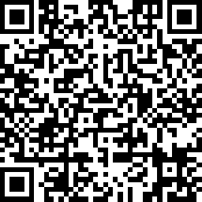
Share here
Your Opinion Matters To Us
We’d love to hear about your experience!
At the end of each session, please scan the QR code or use the link to share your feedback.
Your insights help us improve and make each cohort better than the last.
🔗 https://www.surveymonkey.com/r/MNPB87J
Notes:
Notes
We will be having daily surveys at the end of each class, and your opinion matters to us.
This is crucial in making sure our team can learn the best way to support you, and if we are also hitting the mark, Like real product managers, we would want to iterate and adjust so that we can support your needs.

Slide 43
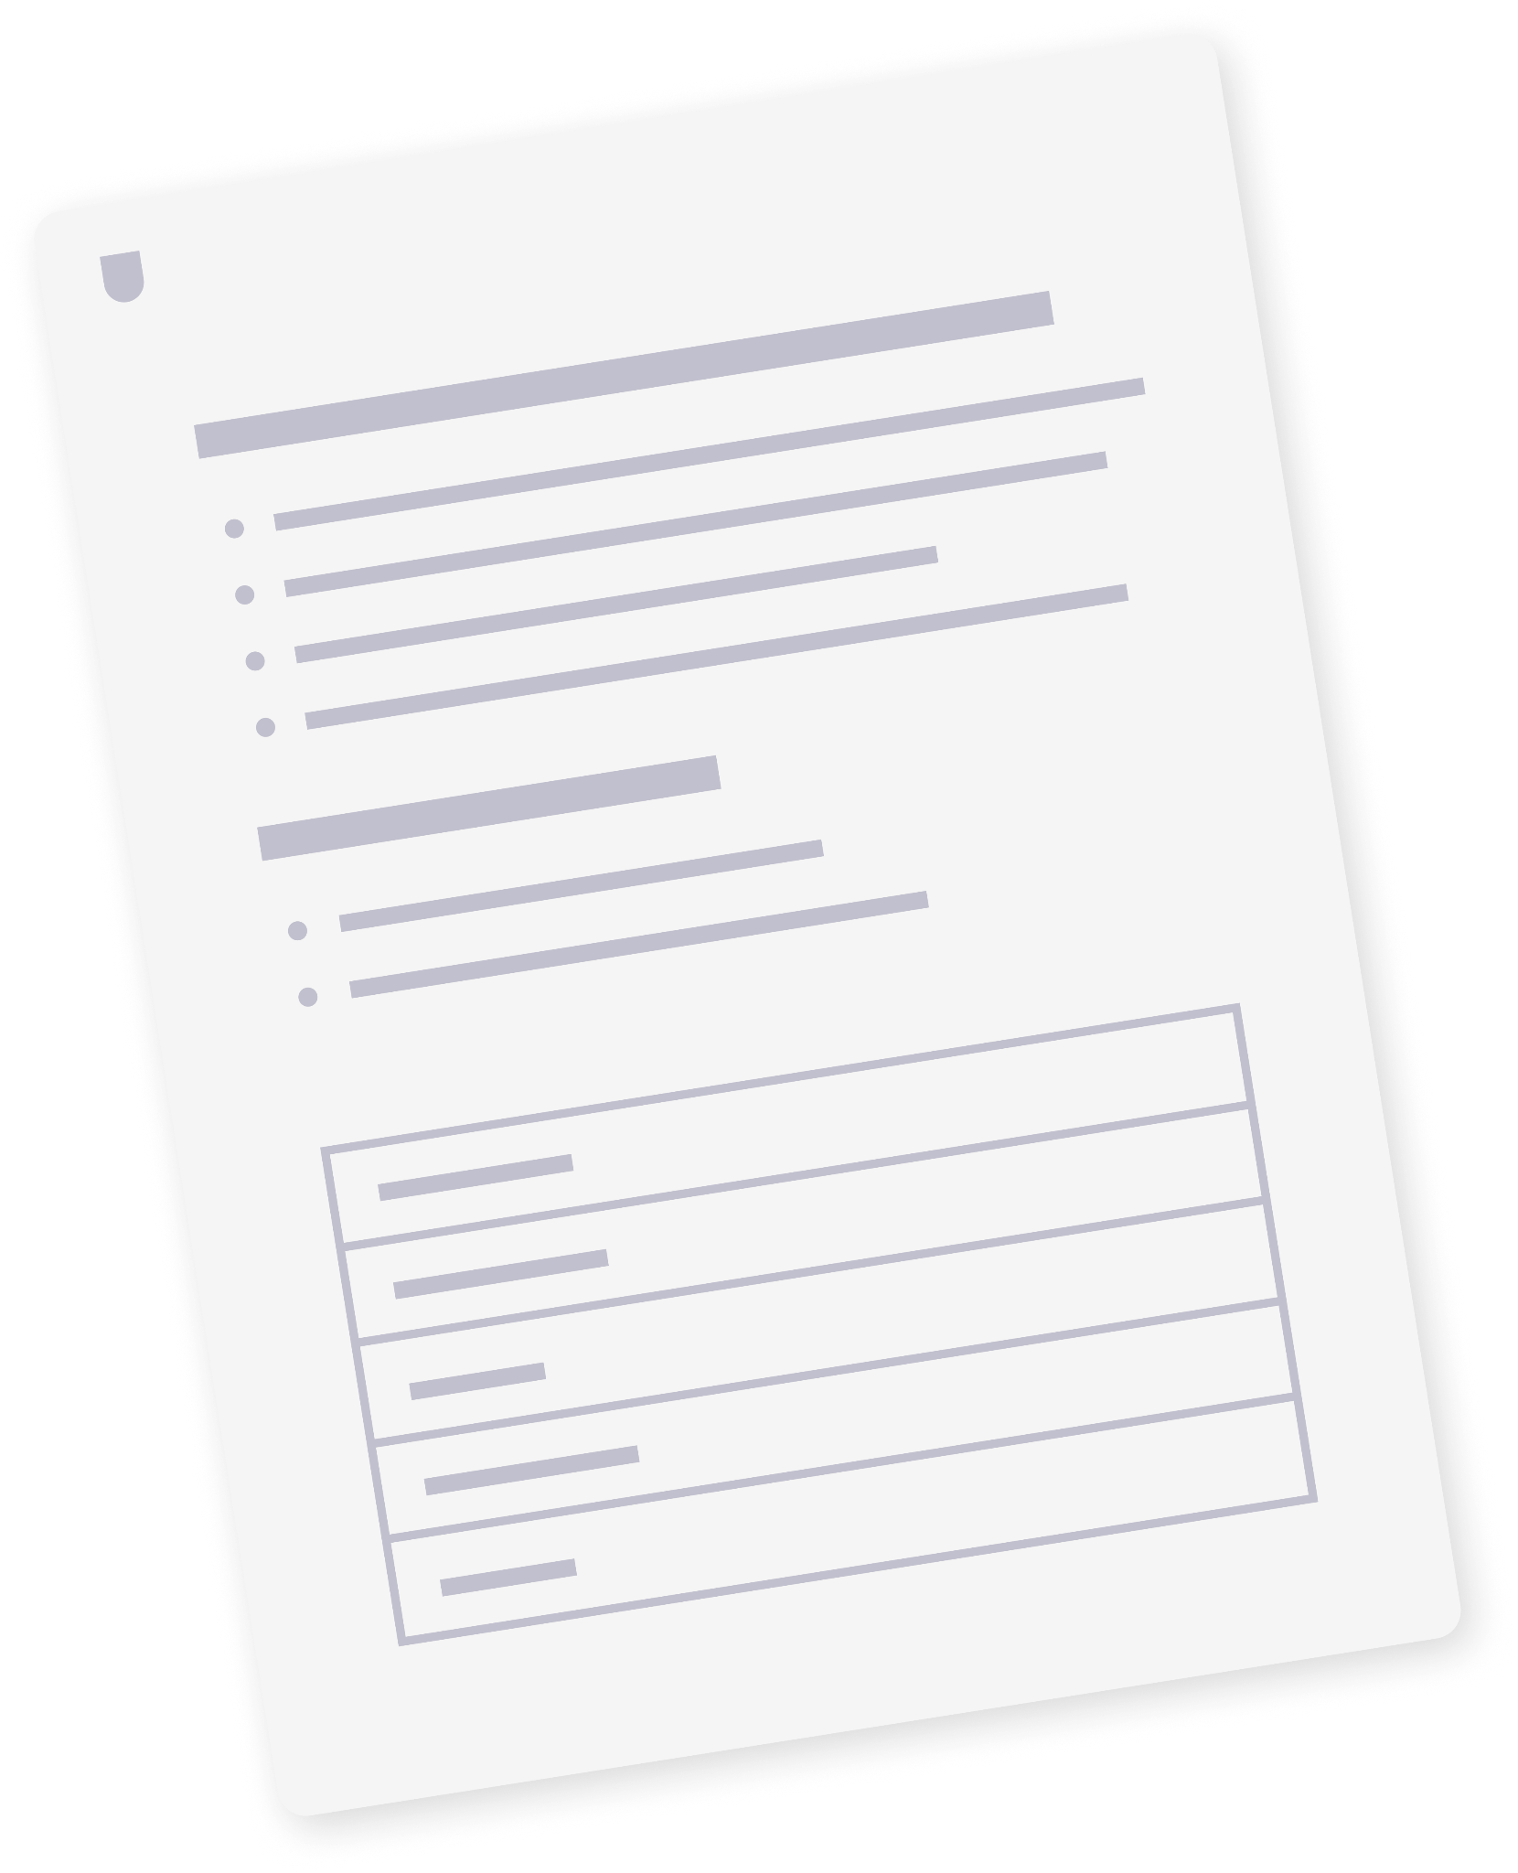
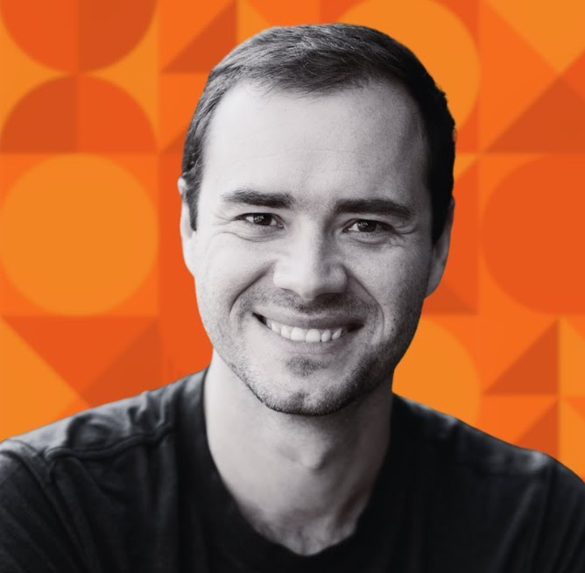


Resources & Templates
AI PROTOTYPING CERTIFICATION
AI PROTOTYPING CERTIFICATION
Final Project Brief & Deliverables
Final Project Deliverables Template
View resource
View resource
VIDEO LESSON
HANDS-ON LAB GUIDE
Software is Changing (Again)
Module 1 Lab Guide
View video
View resource
Notes:
🗂 Resources
Here are resources students can leverage to deepen their knowledge of what we have covered in this class, as well as all materials used for activities.

Slide 44
Q&A
Notes:
Notes
💥Activity: Q&A
This is a chance to dive deeper into the topics covered and answer any additional questions students may have!

Slide 45
Notes:
Thank you 💥

